Slide 1

BookYatra
DevKings

Slide 2
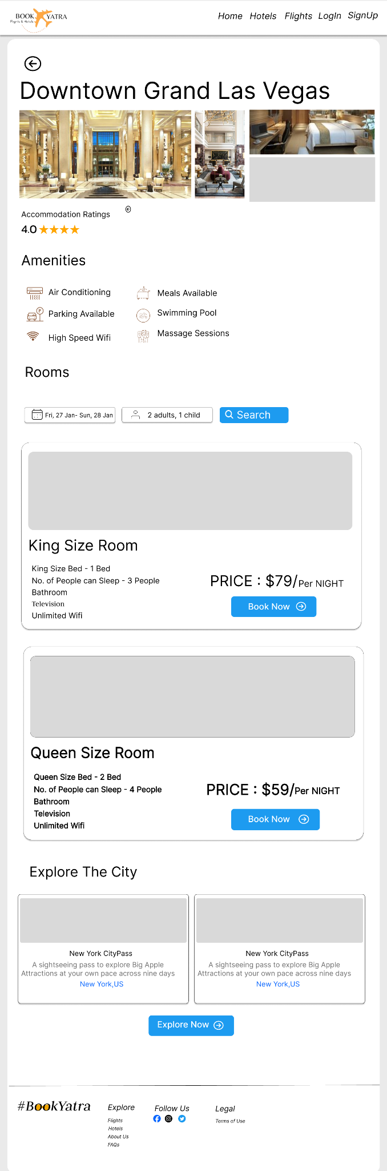
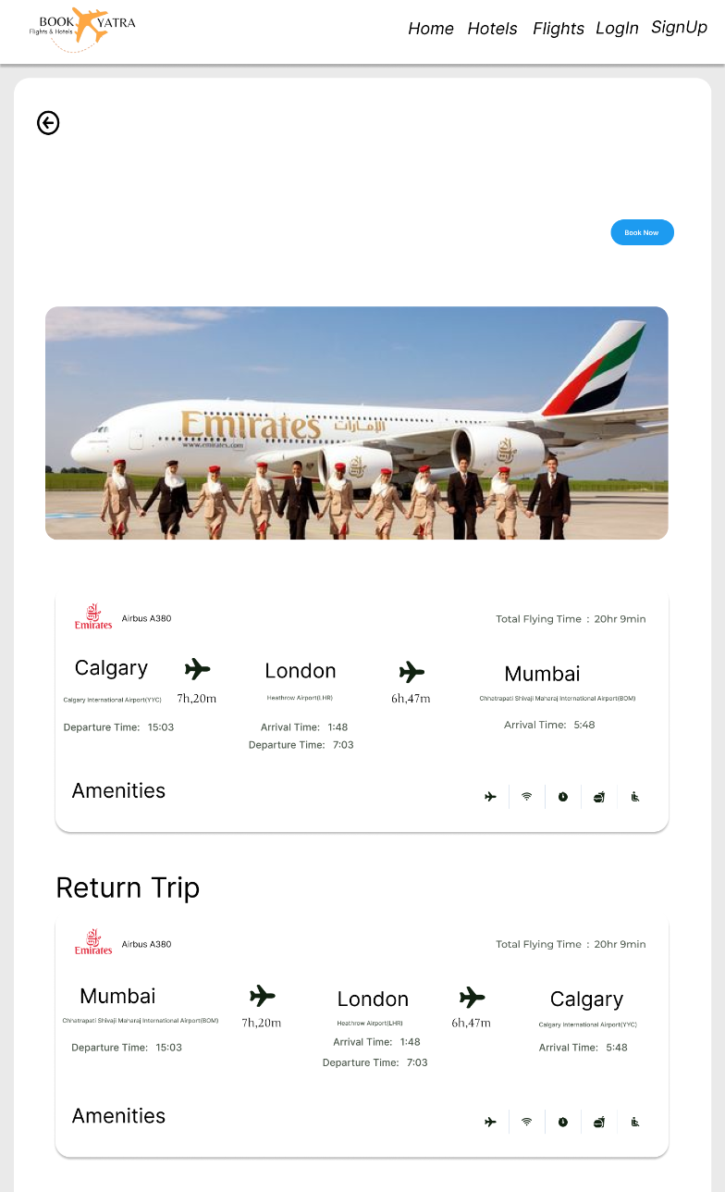
Features - Sourabh
App introduction brief
What it does
Core features
Hotel & Flight Booking: Easy and efficient
Attractions Page: Personalized suggestions
Favorites & Ratings: Tailor your travel experience
Notes:
Our project is BookYatra it’s a flights and hotel booking website that is made to be a seamless, intuitive, and innovative platform which makes your travel booking proces easier.
Some of the main features of our project are:
- A 24/7 chatbot which can answer FAQ’s and help you plan
Additionally, it offers the functionality to mark and save favorite options, allowing travelers to easily revisit and select the best choices for their trips at a later time. This dual-layer approach not only streamlines the planning process but also ensures a customized and efficient travel planning experience, tailored to the unique preferences and needs of each user.
The platform goes a step further by enabling users to meticulously craft their travel itineraries, integrating flight schedules, hotel bookings, and attraction visits into a coherent plan.

Slide 3
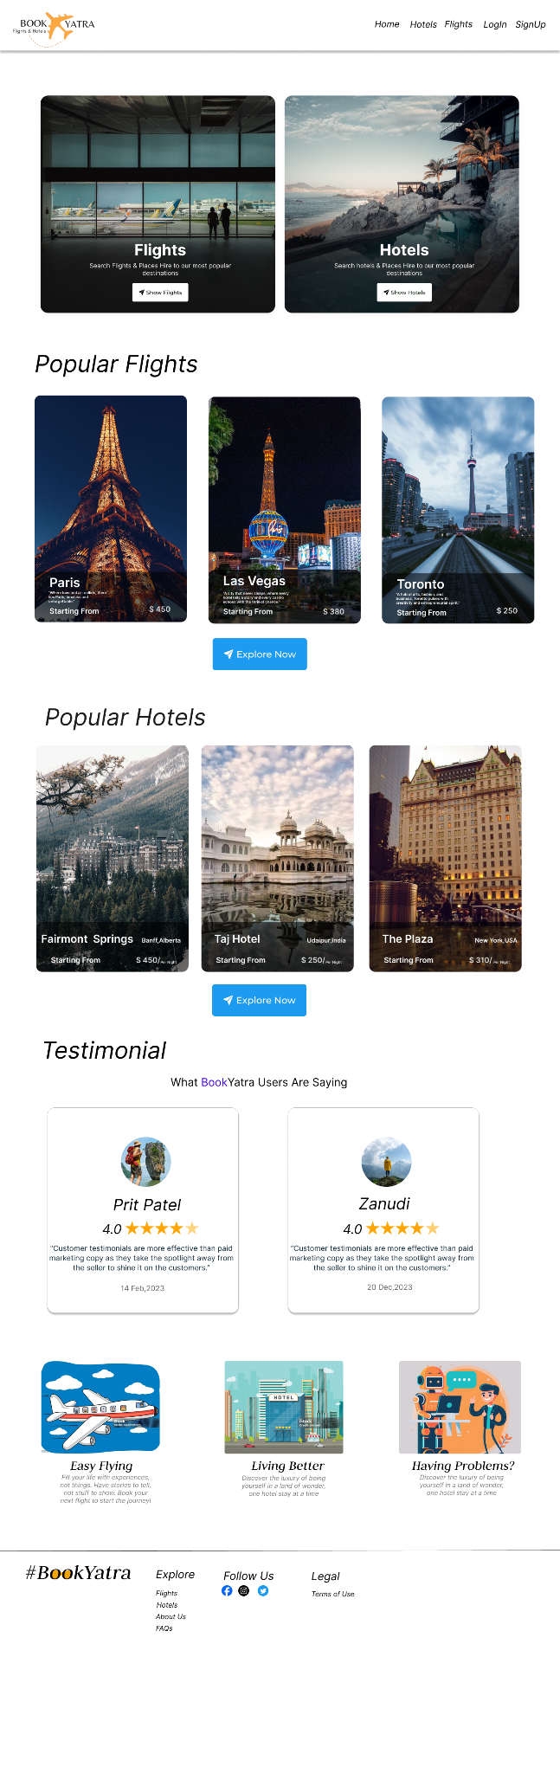
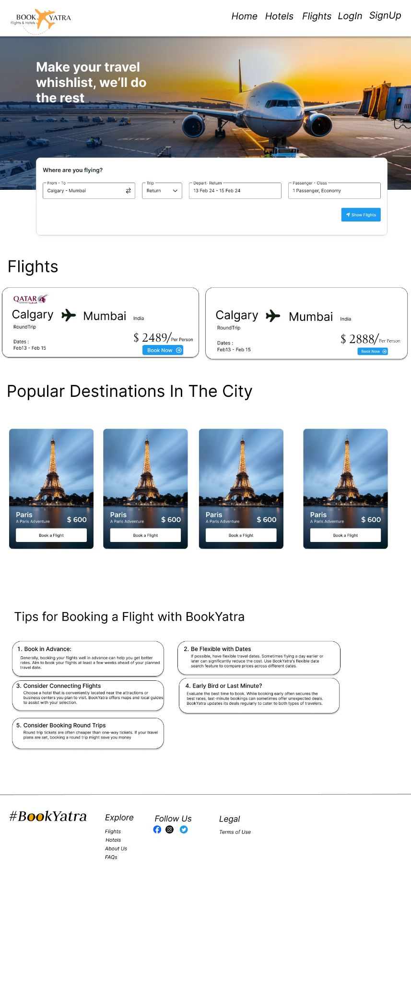
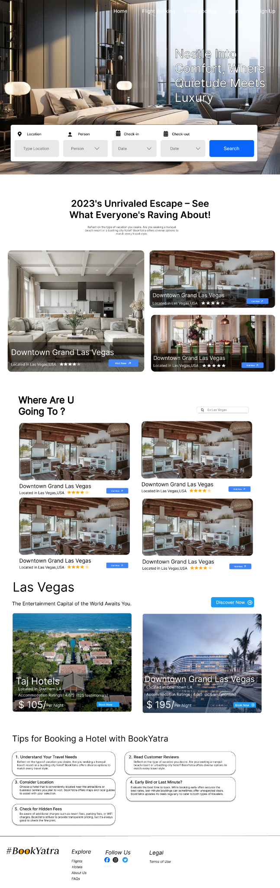
Karm - Figma
We have created figma designs to make sure the the frontend is developed as per this designs.

Slide 4

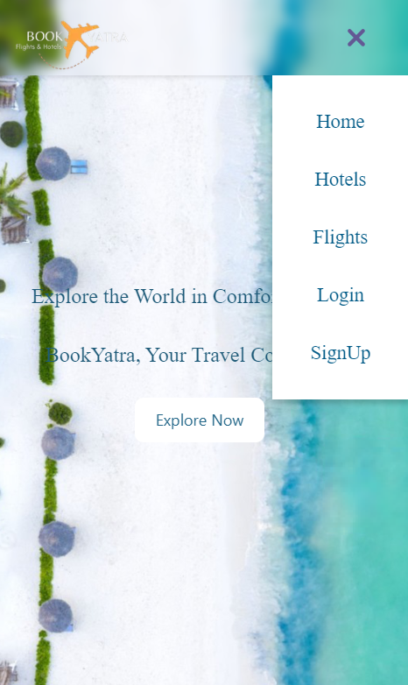
Mausami - Front-End
Landing page, homepage, login/sign up developed
Want front end to be visually appealing
Should work on laptop and mobile
Load time is quick
Desktop View
Mobile View

Slide 5

Use Case - Zainul
Use Case:
User first creates account
Searches hotel using city name, arrival/departure date
Can add favorite hotels which also adds the price of the hotel for the time duration selected

Slide 6




Prit - Backend
Languages we used:
React
Popular framework
We are comfortable
Node.js
API integration easy
Increased speed
CSS
Visually appealing
Works on every device
Firebase
Offers realtime database
Secure and easy to use

Slide 7

Pranjal - Roadmap
Future features
Future functionality
Future ideas
Notes:
interesting

Slide 8

Thanks

